Slide 1



Trains vs Planes: The True Cost of Travel
Makeover Monday 2018
Suyin Lee & Andreas Lezis

Slide 2
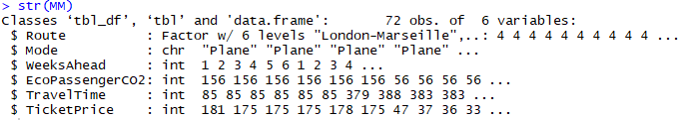
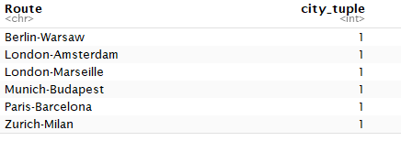
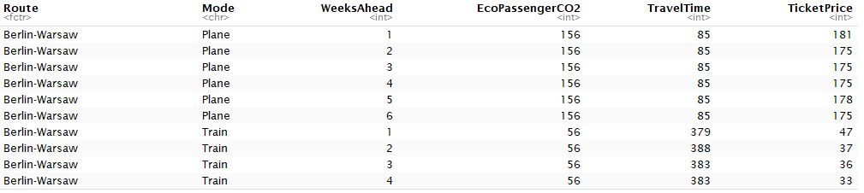
Context: Deutche Welles
The visualizations came from a DW article dated August 29th, 2018
Data journalists Tom Wills & Gianna-Carina Grün
They sampled data to understand the mode of travel that Europeans would be enticed to travel on for relatively short journeys based on ticket prices and further explore the “true costs” travelling by combining monetary cost, time cost, & environmental cost
As such, the graphs visualize more than just a raw dataset – there is a whole set of underlying assumptions & calculations
We decided to replicate 2 visualizations from their model: monetary cost & time cost

Slide 3
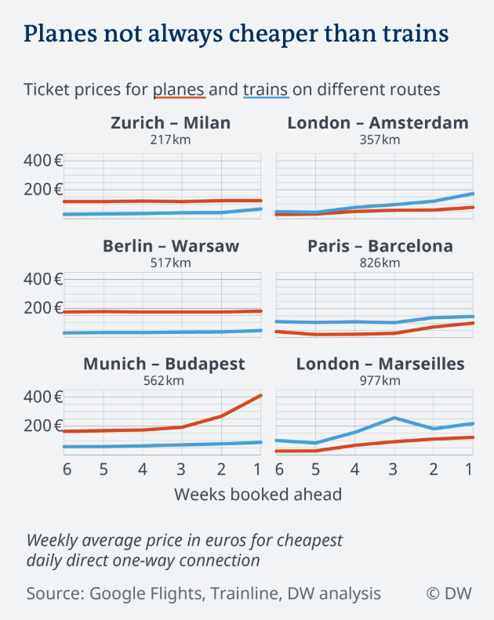
Original Visualization
Examines monetary cost of travel (vertical axis) as a function of number of weeks booked ahead (horizontal axis)
Conclusions made that flights are cheaper than trains where budge airlines operate, while 3 routes offer train savings, and for last minute travel the gap between plane and trains can be narrower
Faceted by six Origin-Destination
Colored by mode of travel (red = plane and train = blue)
Note the fifth variable: distance (km) between each Origin & Destination
Note the legend
Wills, Tom & Gianna-Carina Grün. “Trains vs. planes. What’s the real cost of travel?” Deutsche Welle. https://www.dw.com/en/trains-vs-planes-whats-the-real-cost-of-travel/a-45209552. (Accessed October 30, 2018.

Slide 4
Weaknesses of this visualization?
No information stated on graph on when the data was collected
Not clear how the facets are sorted (left: Trains cheaper than Planes, right: Planes cheaper than Trains)
Not clear where the data for the distance (km) represents, unknown source
Hard to quantify savings/differences
Should we care more about absolute differences in cost (as this graph shows), or relative differences?
Wills, Tom & Gianna-Carina Grün. “Trains vs. planes. What’s the real cost of travel?” Deutsche Welle. https://www.dw.com/en/trains-vs-planes-whats-the-real-cost-of-travel/a-45209552. (Accessed October 30, 2018.

Slide 5
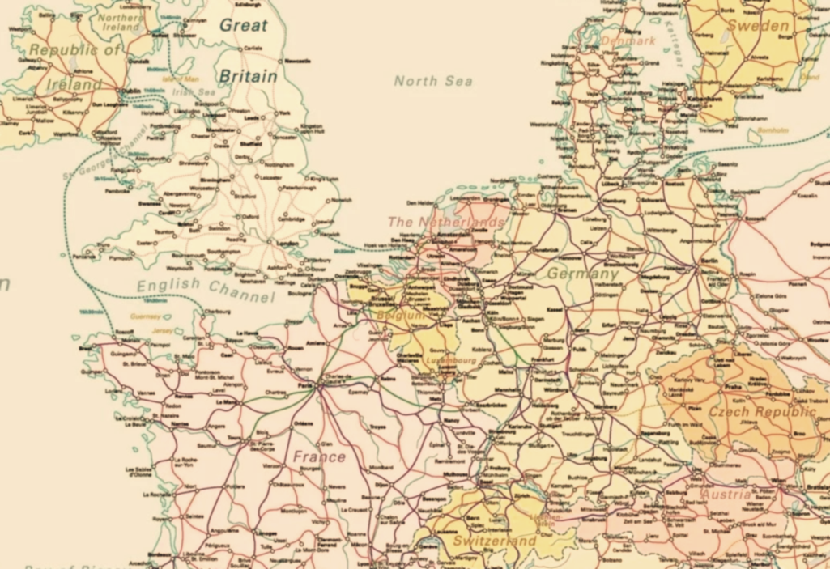
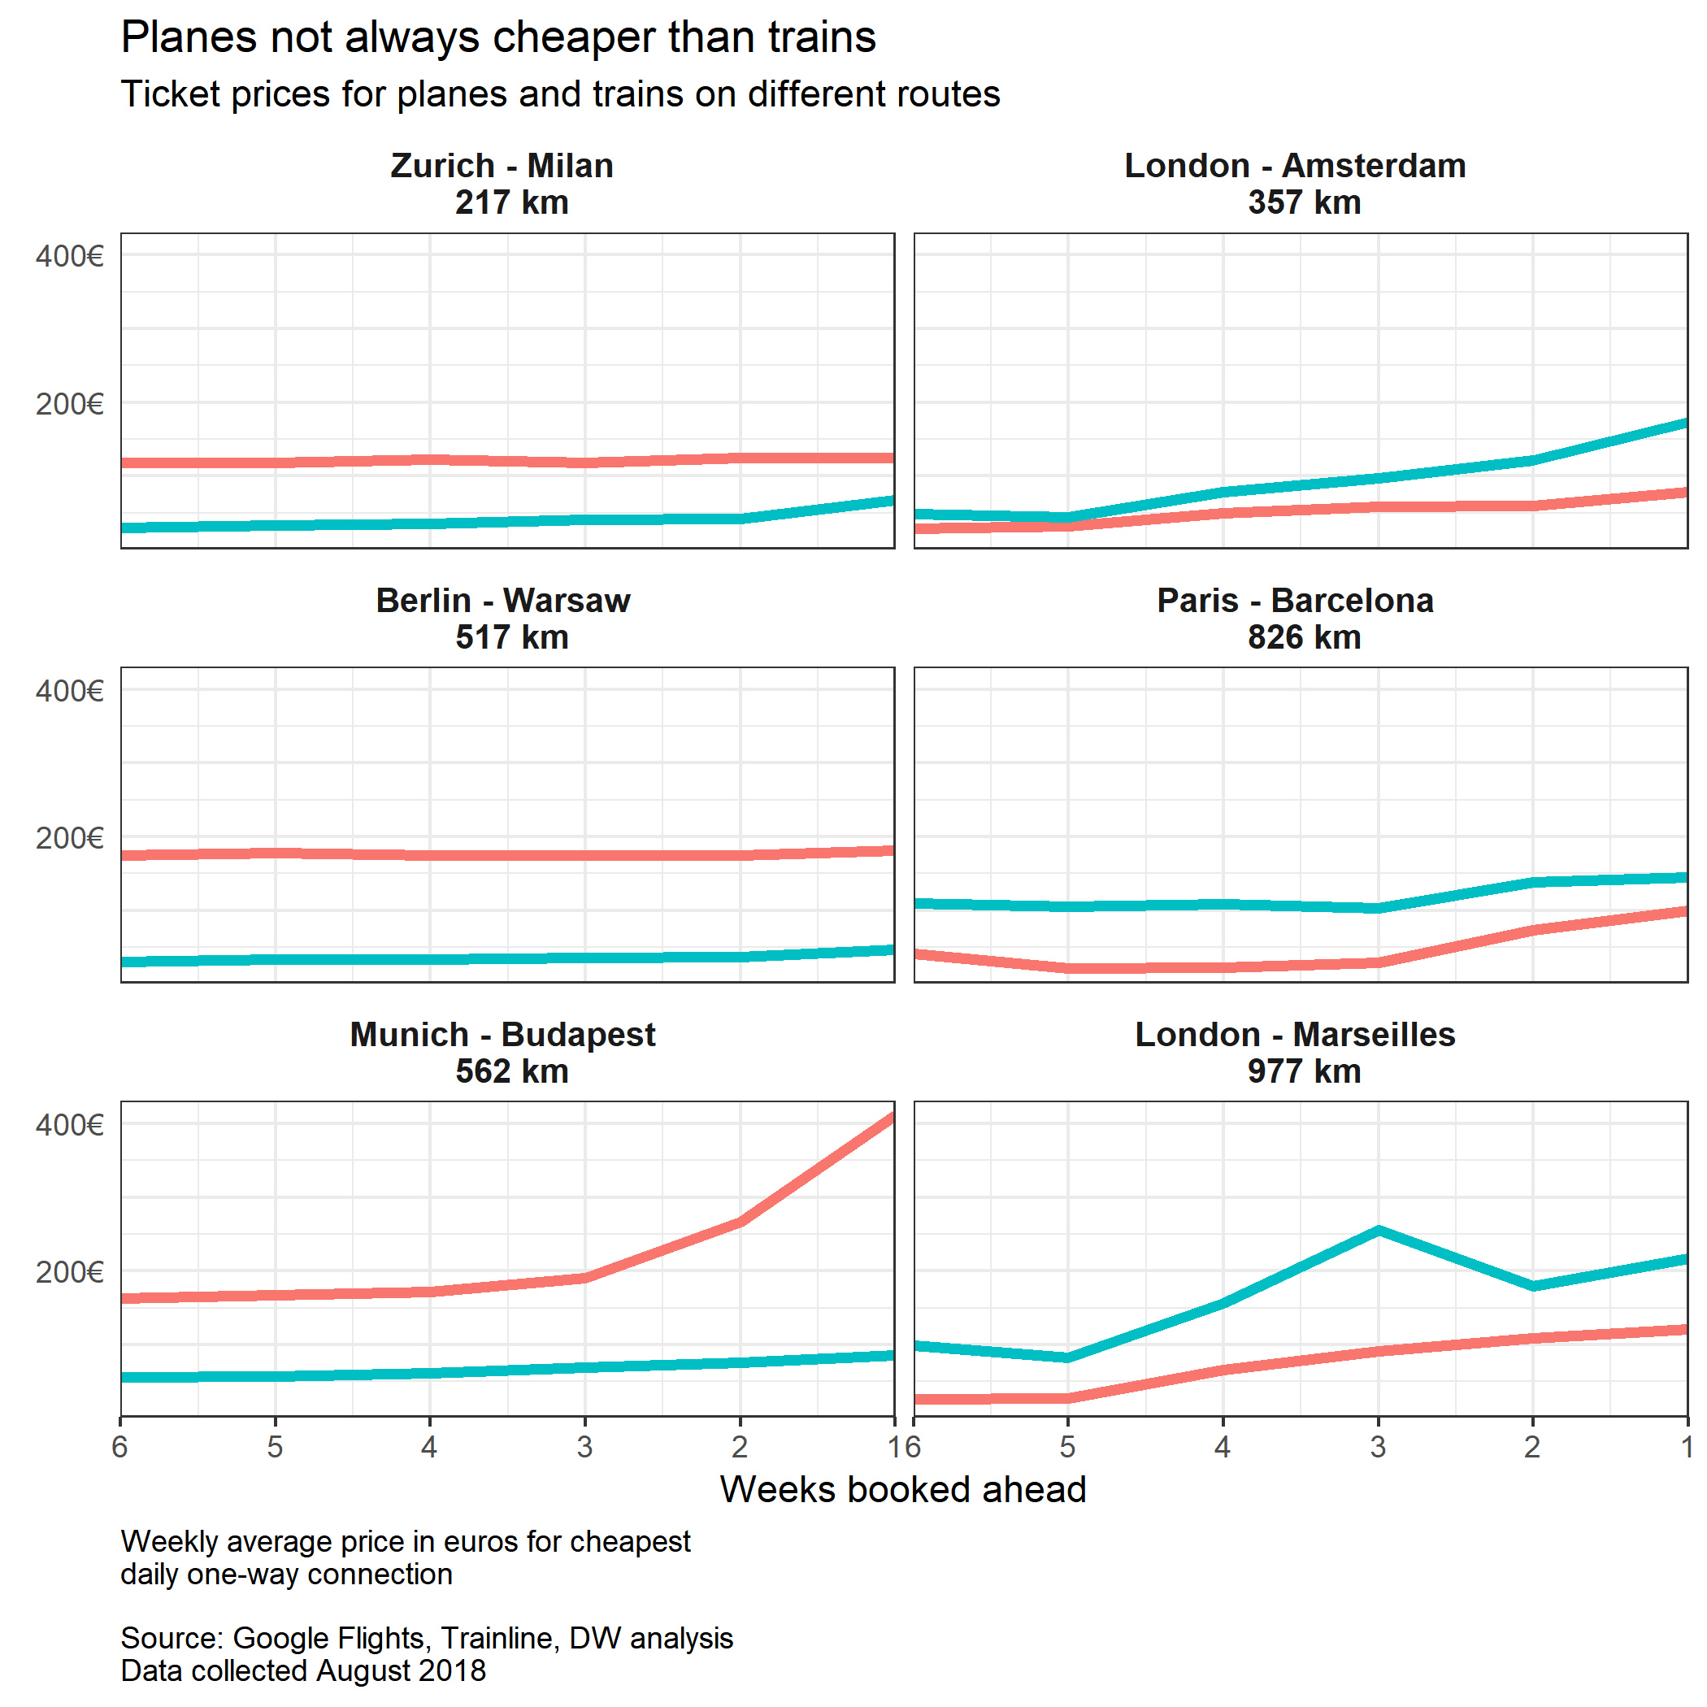
Recreate Original Visualization
Required facet_wrap() to have a 2 by 3 arrangement
Challenge faced with underlining planes vs. trains in subtitle as a legend
Fairly simple visual to recreate otherwise
Still doesn’t quantify the difference (price sensitivity)
Would benefit from adding data labels and some sub-title for each column of facets to call out how routes are arranged

Slide 6
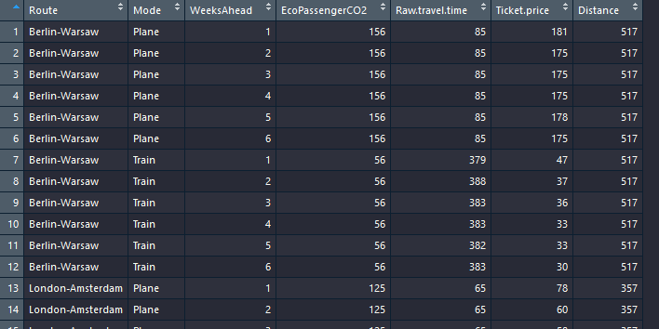

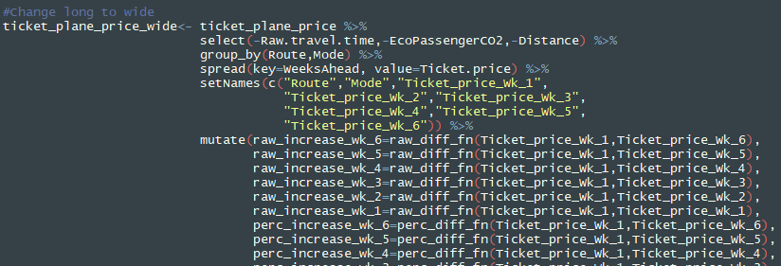
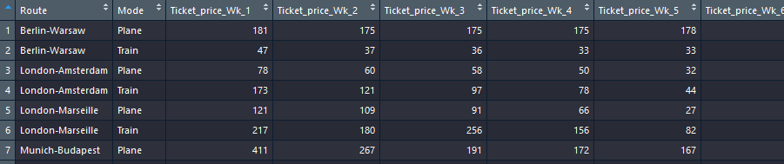
Travel Cost: Data Manipulation
Long
Calculations To explore:
Percent difference between plane and train tickets for each week
Percent difference relative to purchasing the ticket the week prior to departure
Function()
Spread()
Mutate()
Gather()
Wide

Slide 7
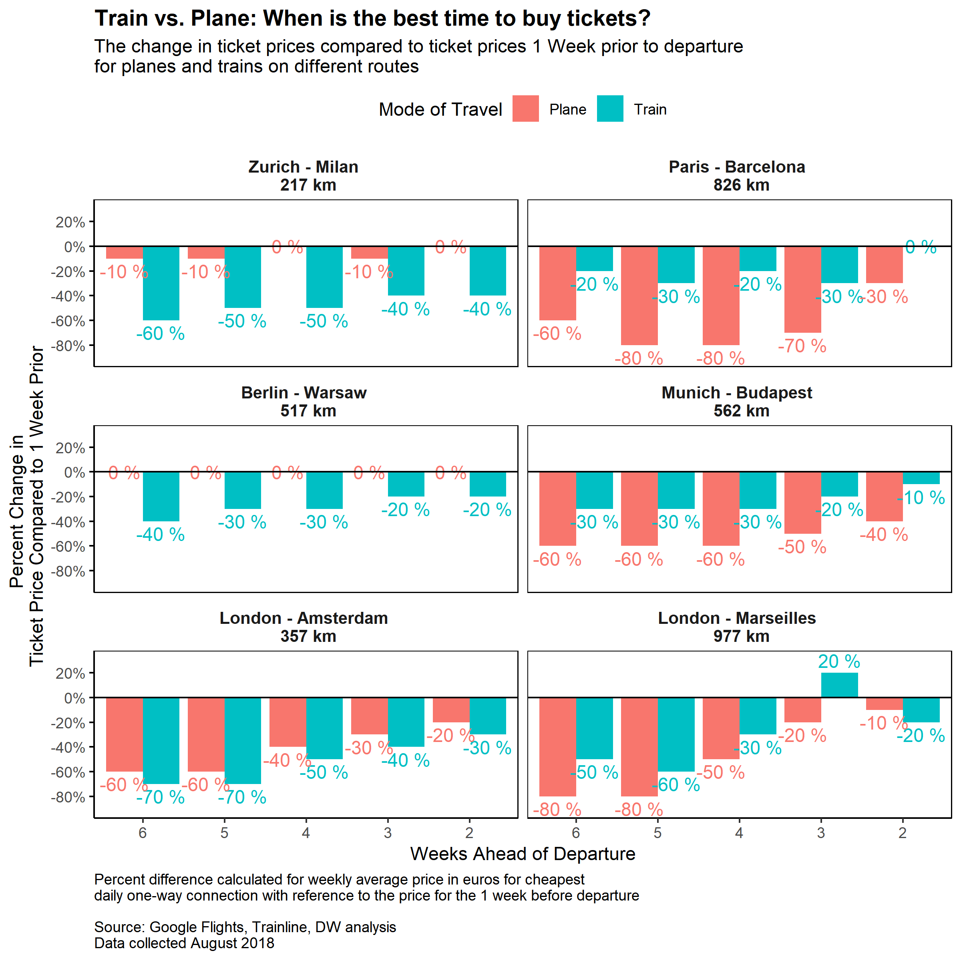
Cost: When is the best time to buy tickets?
Looked at the percent difference between ticket prices in each week compared to week 1
Answers the question of WHEN is the best time to buy tickets for plane vs. train for each route
Pros:
Quantifies the savings when purchasing a ticket ahead of time for each mode of travel
Cons:
Doesn’t address the question of whether planes are cheaper than trains

Slide 8
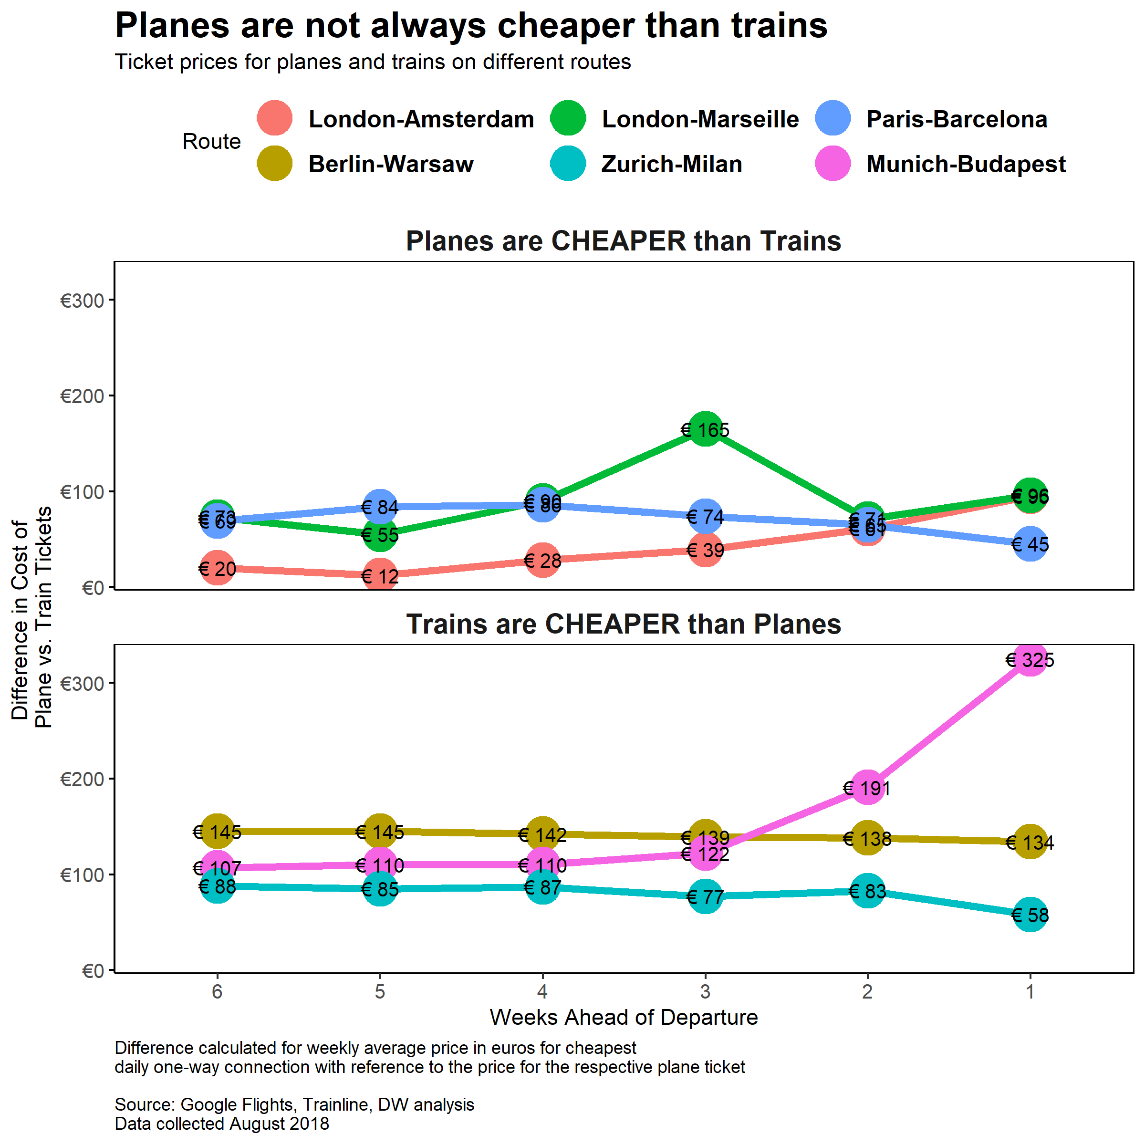
Cost: Are planes or Trains cheaper?
Calculated the absolute difference between plane and train ticket prices for each week
Tried plotting percent difference but too much information
Separating routes where planes are cheaper than trains from routes where trains are cheaper than planes
Pros:
Answers and quantifies how much cheaper are trains vs. planes.
Shows sensitivity of plane and train ticket prices over time
Cons:
Doesn’t fully answer the question on when is the best time to buy tickets

Slide 9
Original Visualization: Time
Examines time “cost” of travel (horizontal axis) for each of six routes (vertical axis)
It’s animated! The animation introduces a new variable: time delay, i.e. the “actual” time cost (applies to planes only)
Colored by mode of travel (red = plane and train = blue)
Note that the time axis is labelled in 30 minute increments
Note the legend
Wills, Tom & Gianna-Carina Grün. “Trains vs. planes. What’s the real cost of travel?” Deutsche Welle. https://www.dw.com/en/trains-vs-planes-whats-the-real-cost-of-travel/a-45209552. (Accessed October 30, 2018.
Reproductions also available here

Slide 10
Weaknesses of the visual?
When were these data collected?
Questionable assumptions underlying the “actual” time
Does the dotted vertical line really convey any additional information?
The frame changes are frustrating and do not enhance our ability to understand the data!
Wills, Tom & Gianna-Carina Grün. “Trains vs. planes. What’s the real cost of travel?” Deutsche Welle. https://www.dw.com/en/trains-vs-planes-whats-the-real-cost-of-travel/a-45209552. (Accessed October 30, 2018.

Slide 11
Data Processing: Time Cost Visualization
Because I layered multiple geoms to plot the points & lines, I needed 2 uniquely formatted datasets
Geom_segment needs only endpoints defined: use a group_by on route only and summarize w/ min() & max()
Geom_point needs coordinates defined, and also mode (for color aesthetic): use a group_by on route and mode, summarize with mean()
Time data is extremely tricky to format & process… spent a lot of sweat and tears only to realize there was an easier way!
Produced the 2 frames of the .gif separately before using gganimate to combine them

Slide 12
Recreate Original Visualization
Required three geoms to plot:
“Displayed time” geom_point
“Actual time” geom_point
geom_segment
gganimate (not yet available on CRAN). Requires a dedicated variable to map to each “frame” of the animation (only 2 here)
Adding a frame variable while maintaining the existing data structure was not trivial (next slide)

Slide 13
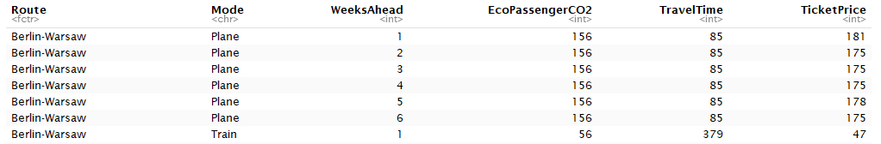
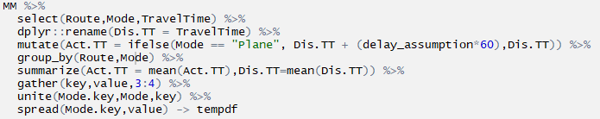
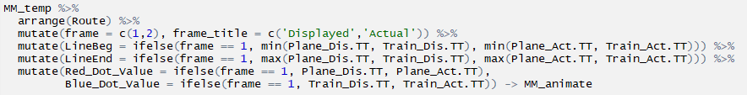
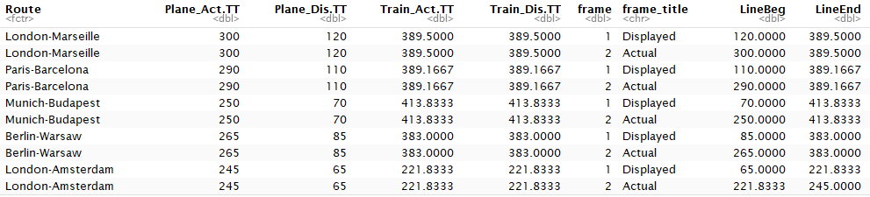
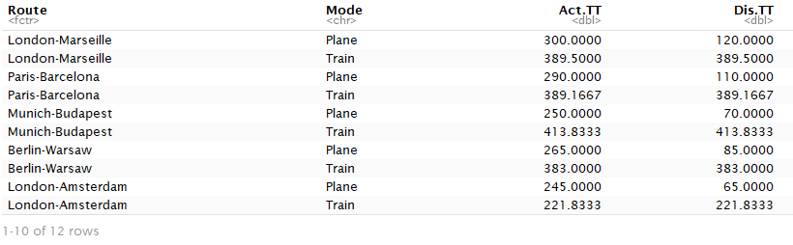
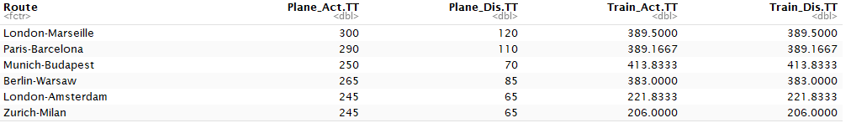
Data Processing Part 2: adding a frame variable for gganimate
I created 2 separate datasets, as before: one to define the geom_segment & another for geom_point
But, I need to represent both the train vs plane data, while adding a new column for the 3 hour delay assumption (hint: the factor levels of delay represent the 2 frames of the animation)
Transpose the data so that each row in the dataset represented a Route-frame dyad (instead of Route-mode dyad)

Slide 14
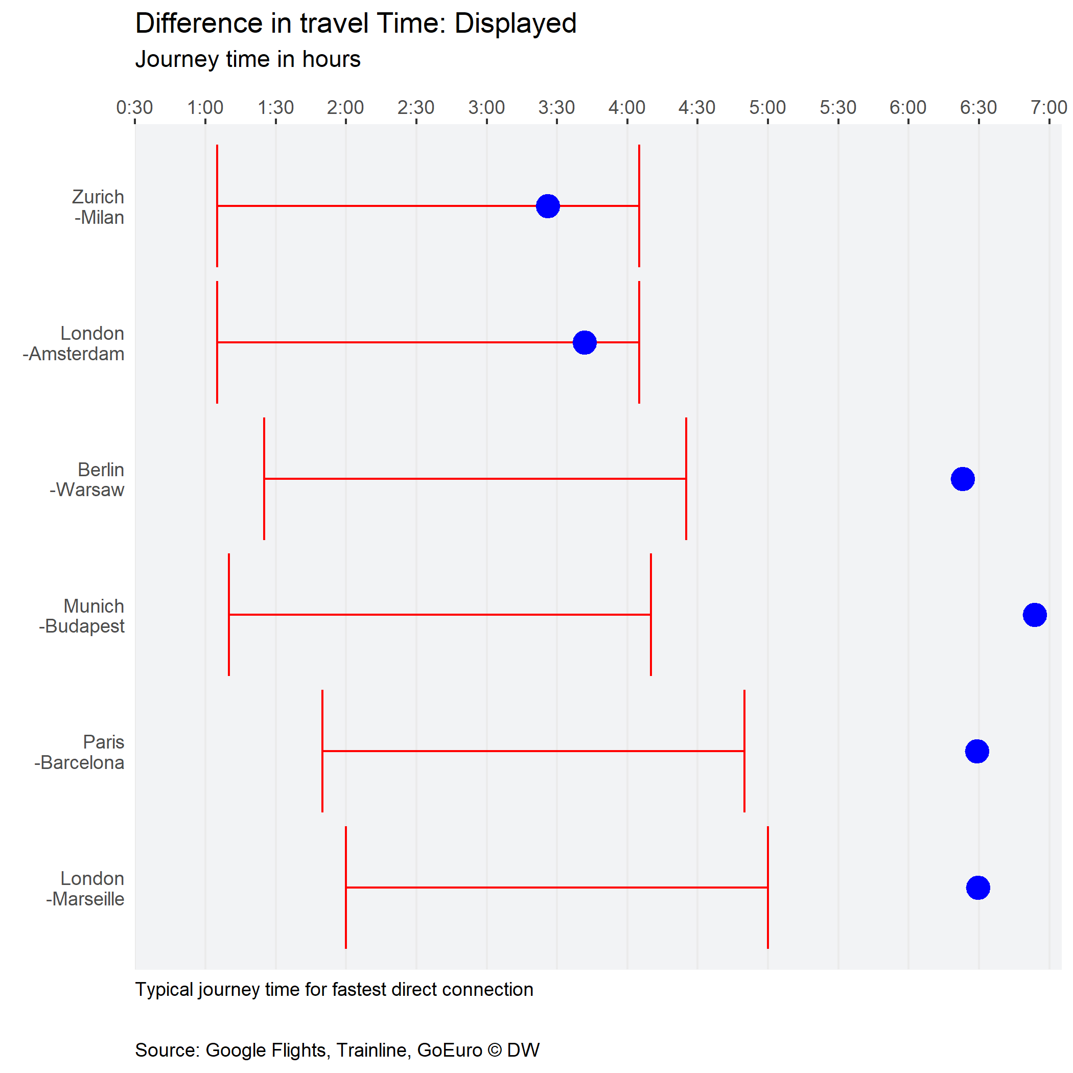
Improving the Original Visualization
Let’s face it… the animation makes it harder to understand the data, not easier
The assumed delayed applied to all plane trips may not be reasonable, or universally applicable – there are ways of conveying the spread of data

Slide 15
Challenges
Recreating the visual – cost
Underlining planes vs. trains as the legend
gganimate not necessarily the right tool for such a simple animation
Verification of data – difficult to add new data without an understanding of their own data gathering process

Slide 16

Further Developments
Understanding how travel seasons and departure/arrival time of mode of travel impacts cost
A set of analyses like this would be best suited for an interactive app – so that users can input their own assumptions, destinations, etc
This Photo by Unknown Author is licensed under CC BY-NC-ND

